Slide 1
Sreenidhi Institute of Science and Technology Yamnampet, Ghatkesar, Hyderabad, Telangana-501301.
Department of Information Technology
PROJECT PRESENTATION
Dr.K Vijaya Lakshmi
M.L.N.Mallika 21311A1252
S.Laxmi Shreya 21311A1244
K.Rohita 21311A1242

Slide 2
Abstract
The transportation sector significantly contributes to greenhouse gas emissions, particularly through conventional combustion engine vehicles.
This research addresses the pivotal issue of carbon emissions from automobiles within the broader context of sustainable transportation.
The need for precise predictive models becomes paramount for informed decision-making.
This is to predict the amount of CO2 that a car will emit using appropriate models. Additionally, it is necessary to determine whether the car is environmentally friendly or based on its carbon footprint.

Slide 3
Existing system
To date, there exist some works that have modeled the global CO2 emission footprint, including the COVID-19 transmission period.
A number of modeling approaches have been tried by various authors from different perspectives to forecast CO2 emissions. Notably, provides insight into the CO2 emission prediction model using ML. CO2 emissions and environmental protection issues.
The used models are
a. Rough K-Means Clustering (RKM)
b.RNN
c.LSTM mechanisms
Previous studies had limitations in qualifying or quantifying measurements of CO2 emissions during and after the COVID-19. This study can be considered the latest nexus of previous work, as most of the previous works did not include the changes in CO2 emissions during the COVID-19 pandemic.
Accuracy obtained is 93%.

Slide 4
Proposed system
Our research aims to address the critical gap in estimating carbon emissions from vehicles. To achieve this, we will utilize a machine learning-centric approach and a diverse dataset encompassing various variables.
Our goal is to build predictive models using different algorithms, including ensemble methods, to estimate carbon emissions from vehicles. The dataset we will be using includes various factors such as make, model, vehicle class, engine size, cylinders, transmission, fuel type, fuel consumption in the city (L/100 km), fuel consumption on the highway (L/100 km), fuel consumption combined (L/100 km), and CO2 emissions.
We will use advanced regression methods, Decision Trees, artificial neural networks (ANN), and the k-nearest neighbors algorithm (KNN) to explore the algorithmic capabilities of predicting carbon emissions.

Slide 5
Methodology
Methods used to train the model are
Decision Tree:- The decision tree algorithm is a supervised algorithm that uses a tree structure. It follows a divide-and-conquer strategy, which is recursive. The decision tree algorithm is used to predict logical results by dividing the tree into subsets. It has an accuracy of about 94%.
Artificial Neural Networks:- This ANN is trained by providing a data set so that it can process and identify the input that is given and give the accurate output. The basic unit of an artificial neural network (ANN) is a neuron.
K-Nearest Neighbour:- K-Nearest Neighbors (KNN) is a simple yet powerful supervised machine learning algorithm used for classification and regression tasks. The functioning of KNN is straightforward. For a given data point, the algorithm identifies its k-nearest neighbors in the training dataset based on a specified distance metric, commonly Euclidean distance.

Slide 6
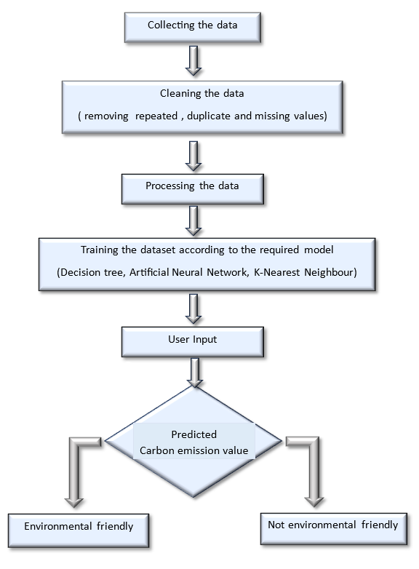
Frame work

Slide 7
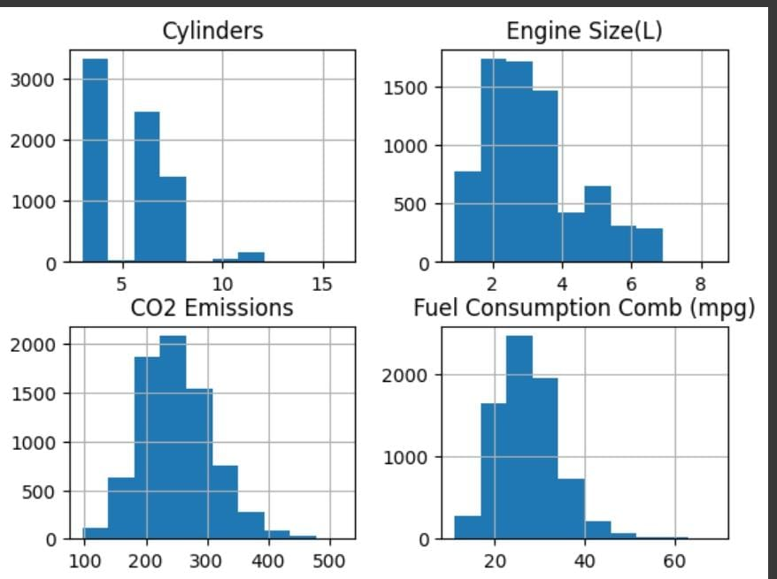
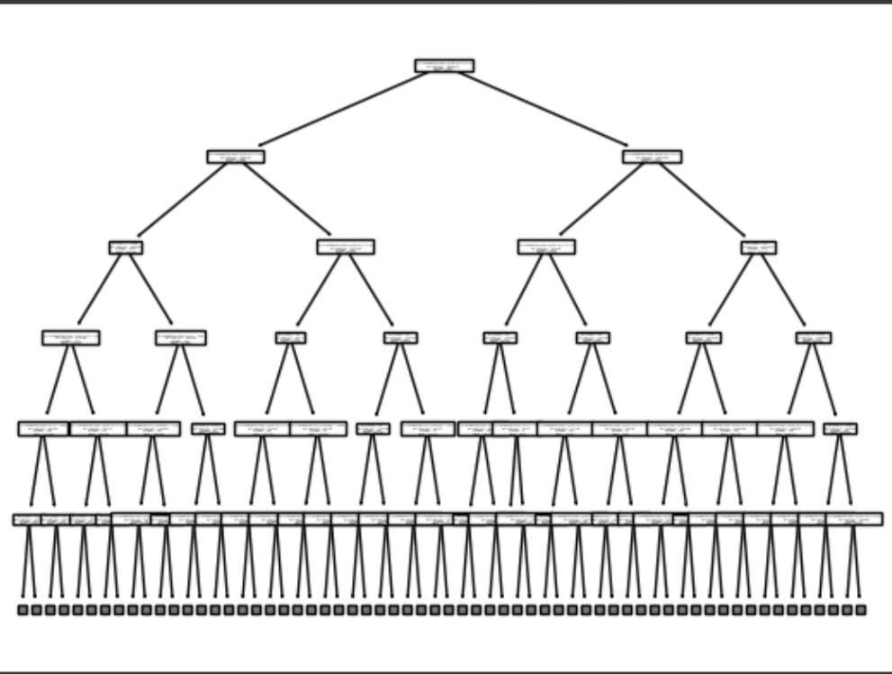
Implementation
Analysis of Data set
Decision Tree

Slide 8
Future enhancement
•These calculate the carbon emission value only for cars .
•This can be further developed so that it can also done for different kind of vehicles.

Slide 9
References
https://cdnsciencepub.com/doi/full/10.1139/er-2020-0019
https://www.kaggle.com/datasets/midhundasl/co2-emission-of-cars-dataset
https://www.kaggle.com/datasets/prathamtripathi/co2-emissions-by-cars-in-canada/data
https://www.mdpi.com/2071-1050/15/9/7615

